Slide 1


AMPAP – Airport Operations, safety, and security
Group#3 – Ioana Rus, John italume, ken cooper, Kathryn Prendergast, ruben Martinez, & saif tabook
Challenges to the aviation industry within the next decade

Slide 2
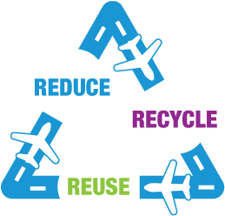

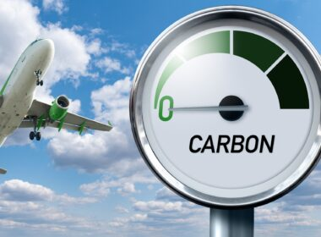

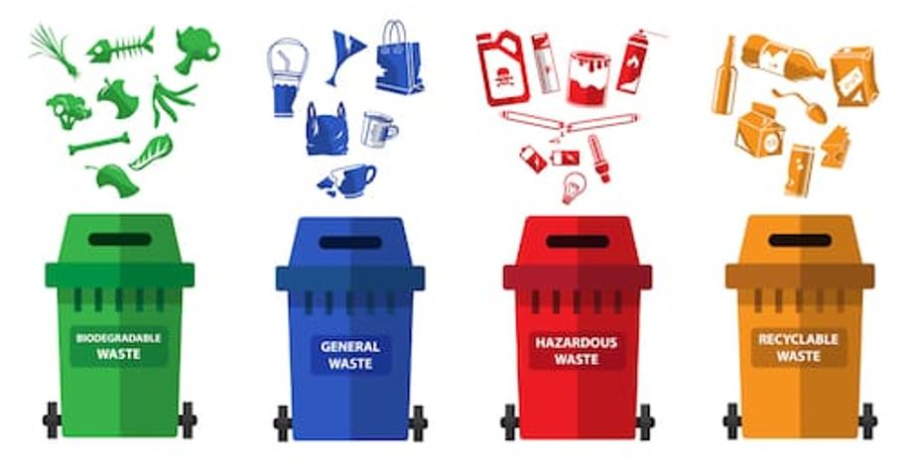
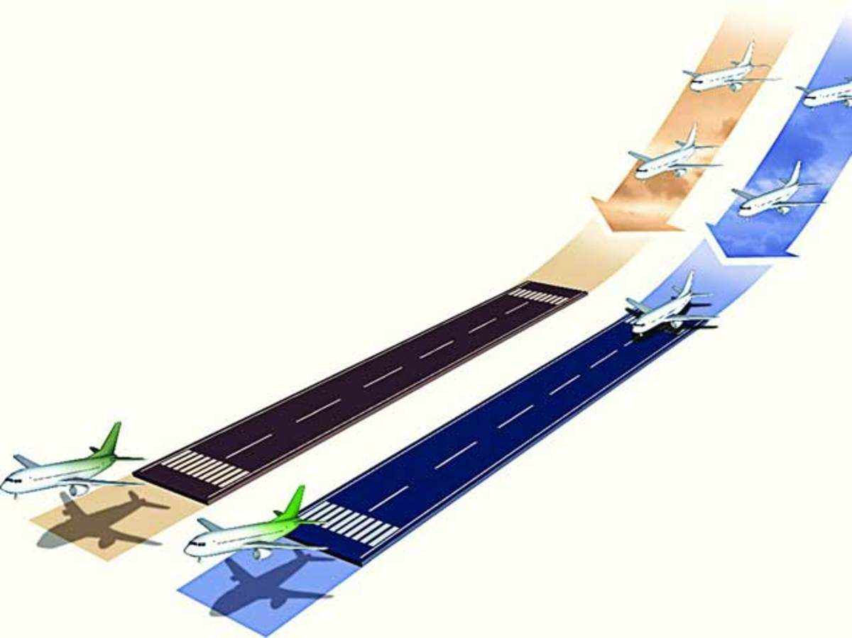

Challenge#1 - environment
Notes:
Aviation is a significant contributor to GHG
Aviation commitment to ZERO emissions by 2050
reduce, reuse, recycle initiative in all aspects of aviation operations & activities
expansion into renewable sources to reduce use of fossil fuel where possible e.g. electricity
monitoring and management of airside activities both aircraft and air handlers movement
Reduce and reuse of water consumption
Reduce and recycle of waste management

Slide 3
Challenge#2 – Airport facilities (infrastructure)
LANDSIDE FACILITIES
Access Roads & Parking Areas
Departure Process & Terminal Capacity
Improved Efficiency in the Security & Border Control Process
Signage & Way-Finding Process throughout Terminal

Slide 4
Challenge#2 – Airport facilities (infrastructure)
AIRSIDE FACILITIES
Runway & Taxiway Capacity
Apron Layout & Ground Movement Process
ATC SOPs for Inbound & Outbound Movements

Slide 5
Challenge#3 – Passenger experience revolution
Improvement of Existing Airport Experience
Lounges, free Wi-Fi, & variety of food & retail concessionaires, integrated services
Expansion into New Airport Experiences
Cinemas, pools, reading areas, sports halls, virtual-reality & gaming options
Travel Applications
Valet services for personal luggage while waiting for flights (increased roaming & shopping opportunities for passengers)
Reservation options for restaurants
Booking & payment of parking
Access to concessionaires for shopping

Slide 6
Challenge#3 – Passenger experience revolution
Advanced Baggage & Passengers Monitoring & Control Technology
Improvement is SMART Technology for Passenger Experience sharing and feedback
Increased processes for understanding Passenger Needs and Expectation during travel
ASQ surveys, Focus Groups, Internet/Social Media, Interception Surveys and Suggestion/Comment Cards

Slide 7
Challenge#4 – Airport & Airlines Relationship
S/N | ISSUES | CHALLENGES | WAY FORWARD
1 | Charges | The Airport management is aimed at achieving increased revenue by setting higher user charges however, Airlines will prefer lower user charges so as to improve their profit margin. | Airport business is a premium which must ensure optimum control and satisfaction of all stakeholders. User charges must be set to consider the interest of Airport users so as to ensure sustainability of the Airport business.
2 | Contracts | Contracts agreement between Airlines and Airport management are always subject to terms and conditions set by relevant regulations. | Prioritizing the need of the passengers and other Airport users in contract agreement is very essential as the Aviation business
Notes:
The Airport business is being regulated by various international standards however, the major stakeholders in the business sustain commercial relationship which keeps the business operations efficient. Airports enter into various types of commercial contracts. Some of the most common include: Airline agreements. These contracts must consider factors such as length of term, control of space, vacancy risk, insurance, and aviation security.
The relationship among Airlines and Airports is mostly established through user agreements or contracts which basically designs the procedures of calculating and collecting charges and fees.
The Airlines will always prefer lower user charges and an efficient service provided by the Airport. The Airlines needs maximum customers satisfaction so as to avoid the risk of being penalized however, basic parameters needs to be considered so as to ensure the objectives of the Airport is not jeopardized. In most countries, the Airlines and Airports have service level agreements so as to ensure maximum services however, this form of agreement may lead to increase control of the Airport business by the Airlines as they tend to have the operational capacity to influence the decisions of the Airport management in the next future.

Slide 8
Challenge#4 – Airport & Airlines Relationship
3 | Aviation policies | Conflicts in certain policies regulating the Airlines and the Airports may impact on the sustainability of the Aviation business. | There is a great need to unify the regulating policies in the Aviation business. Civil Aviation Authorities may need to ensure policies regulating Airport business does not conflict the business of the Airlines as Airport managers must have maximum control on the Airline operators.
4 | Facilitations | Airport facilitation is the responsibility of the Airport management as this tends towards creating a favorable customer experience. Airlines sometimes want to provide theses service by way of lounges. | The Airport managers must rise up to the task of ensuring efficiency in airport users satisfaction.

Slide 9
Challenge#5 - technology
Increases in weather extremes will require more precise fleet and schedule planning by airlines and technical performance by Air Navigation Services Providers (ANSPs).
Increased dust and heat from global warming will affect aircraft engine performance, requiring design and material changes. In addition, alternative fuel technology is critical to achieving net zero emissions.
Airport and Aircraft cooling systems will require technical innovation to cope with new heat extremes, for employee and passenger comfort and safety.
Rising temperatures will generally reduce airframe lift, requiring that aircraft engines and surfaces will require redesign. Without changes, payloads (passengers or cargo) will have to be reduced.
Passenger Experience: Smoothing and speeding the airport/airline experience by reducing personal physical contact and pausing/queuing will require improved technology design and performance
https://www.icao.int/environmental-protection/Documents/Factsheet%20Business%20and%20Economics%20Final.pdf

Slide 10


Challenge#5 – technology The Evolution of Airports - A FLIGHT PATH TO 2050
Technology will make airports more efficient, especially if regulators agree on a common set of rules
2030
• Biometrics and digital identity management
• Walk-through, contactless immigration
• Paperless or tag-less tracking of baggage
• AI and IoT deployed as a core part of airport operations
• Additive manufacturing and 3D printing supply chains
2040
• Autonomous vehicles and robotics deployed to support operations airside and landside
• Walk-through, contactless security
• Improved aircraft noise performance profiles
• Use of AI and ML to predict and optimize operational performance
• Carbon capture and storage technology
2050
• A fully automated, On-the-Move, contactless experience
• An internationally recognized digital identity owned by passengers
The Evolution of Airports - A FLIGHT PATH TO 2050
https://www.oliverwymanforum.com/mobility/2023/jun/airport-evolution-travel-trends-by-2050.html
https://store.aci.aero/product/the-evolution-of-airports-flightpath-to-2050/
Notes:
The Evolution of Airports - A FLIGHT PATH TO 2050
https://www.oliverwymanforum.com/mobility/2023/jun/airport-evolution-travel-trends-by-2050.html
https://store.aci.aero/product/the-evolution-of-airports-flightpath-to-2050/
2030
• Biometrics and digital identity management
ICAO DTC (Digital Travel Credentials)
SITA DTC - Aruba Happy One Pass https://youtu.be/cNmQAEjwPjA
• Walk-through, contactless immigration
EU-LISA Enabling Seamless Travel to the European Union Research Monitoring Report (Dec 2022)
https://www.eulisa.europa.eu/Publications/Reports/eu-LISA%20-%20Seamless%20Travel%20Report%202022.pdf
SITA Digital Borders of the Future: https://youtu.be/QzZ3QJU4xc0
Walking immigration corridors
• Paperless or tag-less tracking of baggage
“Bagometric Trial” → Biometric technology applied to bags able to differentiate a white sheet of paper from another
• AI and IoT deployed as a core part of airport operations
AI and IoT supporting simulation of pax flows
Digital Twins
• Additive manufacturing and 3D printing supply chains
2040
• Autonomous vehicles and robotics deployed to support operations airside and landside
Drones supporting MROs
Driverless pushbacks
Leo, SITA's baggage robot https://youtu.be/W3WaNHzE9SU
Floor cleaning robots
• Walk-through, contactless security
Walking security corridors
• Improved aircraft noise performance profiles
• Use of AI and ML to predict and optimize operational performance
AI and ML applied to video streaming to automate time stamping of handling activities at ramp
• Carbon capture and storage technology
2050
• A fully automated, On-the-Move, contactless experience
SITA Digital Borders of the Future: https://youtu.be/QzZ3QJU4xc0
• An internationally recognized digital identity owned by passengers
ICAO DTC (Digital Travel Credentials)

Slide 11
QUESTIONS?
Group#3: ioAna, john, ken, Kathryn, ruben, & saif

